Slide 1

Mini Project 2
Shrey Parekh
Notes:
Photos by Freepik

Slide 2
Humans response to death by stroke
An analysis performed to determine stroke detection from different factors.
Notes:
Photos by Freepik

Slide 3
Agenda
01
Background
06
Statistical Analysis
Context on the business objective
Identify and analyze potential trends between the features
02
Preprocessing
Business objective
07
Describe the problem statement
Cleaning the data, Imputation of the data
03
08
Classification and Applying techniques
Data Pipeline
Describes the wrangling and transformation of data
Logistic regression, SVM, Naïve Bayes, cross validation
04
Dataset
Information on the dataset
05
Data Exploration
09
Summary
Conclusion, Limitation and
Next steps.
High level analysis of the characteristics within the data

Slide 4
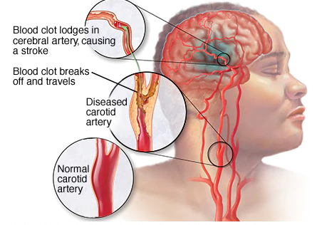
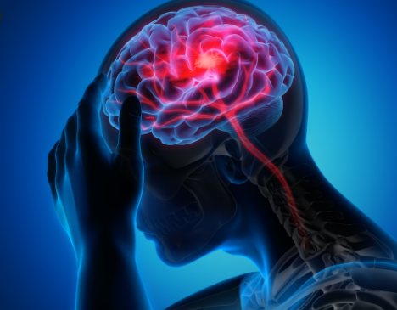
Background
Context
Stroke occurs when the blood supply to the part of your brain is interrupted or reduced.
This prevents the brain tissue from getting oxygen and nutrients.
Brain cells then begin to die in a matter of minutes.
A stroke is a medical emergency, and an early treatment is crucial as it can reduce brain damage and other complications.
Notes:
Photos by Evening_tao / Freepik

Slide 5
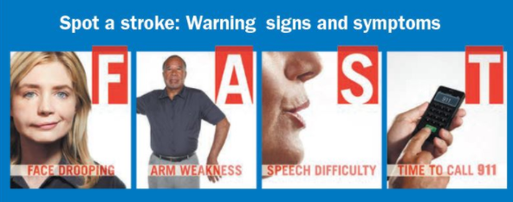
Background Continued
Context
Literature review from an article of social science and medicine published in September 1999 suggests that stroke has a negative impact on family members as quality of life deteriorates while taking care of members affected by strokes.
According to the World Health Organization stroke is the 2nd leading cause of death globally.
Stroke is responsible for approximately 11% of total deaths
This dataset is used to predict whether a patient is likely to get stroke based on the input parameters like gender, age, various diseases and smoking status.
Each row in data provides relevant information about patient.
Notes:
Social Science & Medicine
Volume 49, Issue 6, September 1999, Pages 711-725

Slide 6
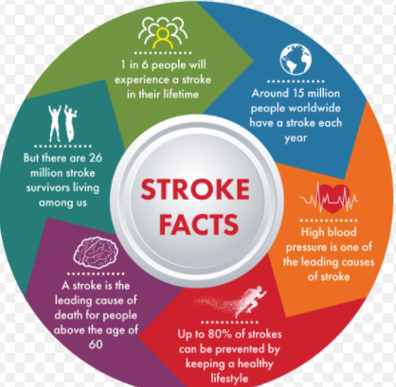
Business Question
What factors affect human death by stroke?
Is there an association between the factors such as age, gender, BMI in detecting stroke?
Why Ask this Question?
This is important because we must understand what are the reasons that cause stroke to people.
If we can detect stroke successfully then we can help the community in preventing stroke.
So, we will use machine learning techniques on some features to detect strokes.
Notes:
Photos by Freepik

Slide 7

Data Science Pipeline
Data Acquisition
Preprocessing
Applying techniques
Cross Validation
Next Steps
1
2
3
4
5
6
7
Data Exploration and
Statistical Analysis
Classification
Logistic Regression
SVM
Naïve Bayes
Results

Slide 8

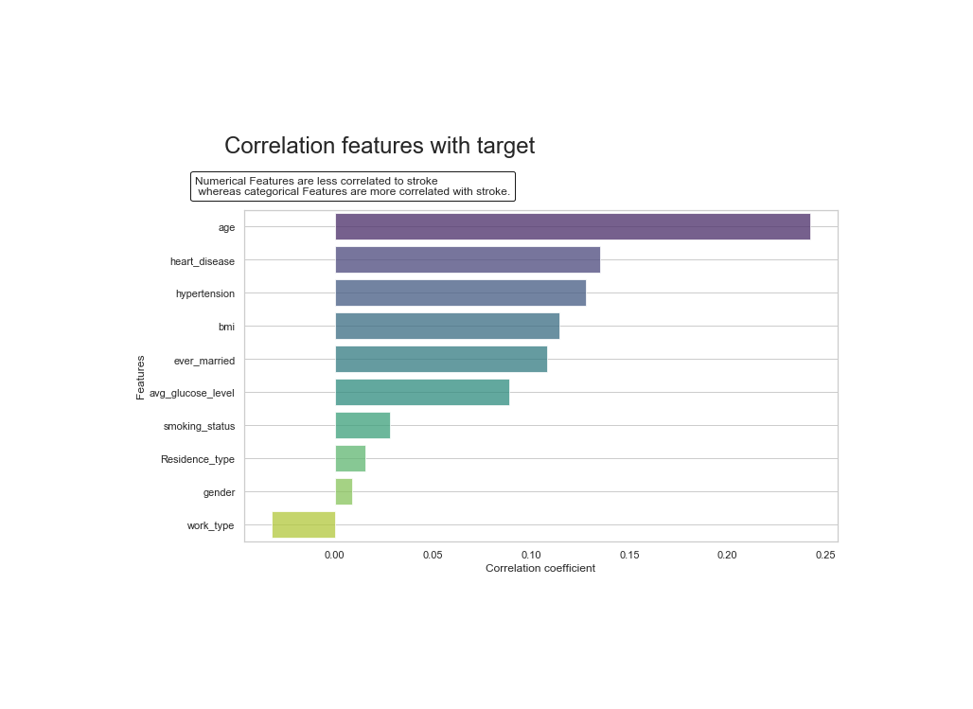
Data Set contains 12 Features
Notes:
Photos by rawpixel.com / Freepik

Slide 9
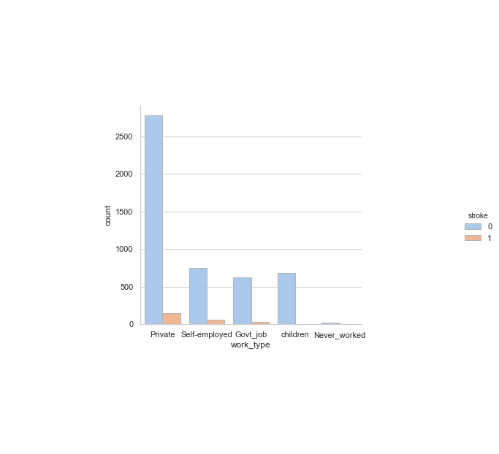
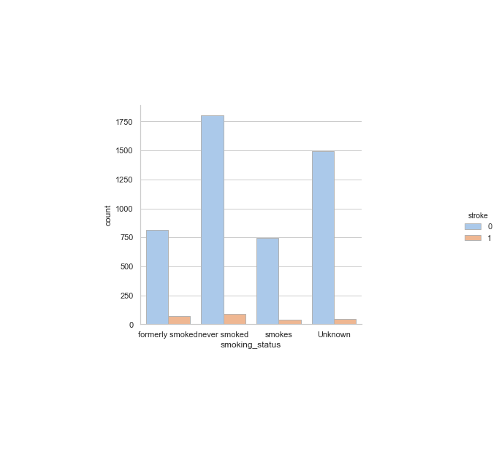
Data Exploration and Statistical Analysis
The plot shows insights of categorical features.
The insights we can derive from this are that private and self employed have similar proportions of stroke. Whereas government jobs are due to having less stroke, children are not likely to have a stroke.
Another insights we have is that their is not strong correlation in the amount of strokes gained by smokers as their is similar distribution to a person getting stroke no matter what they smoke or they haven't smoked.

Slide 10
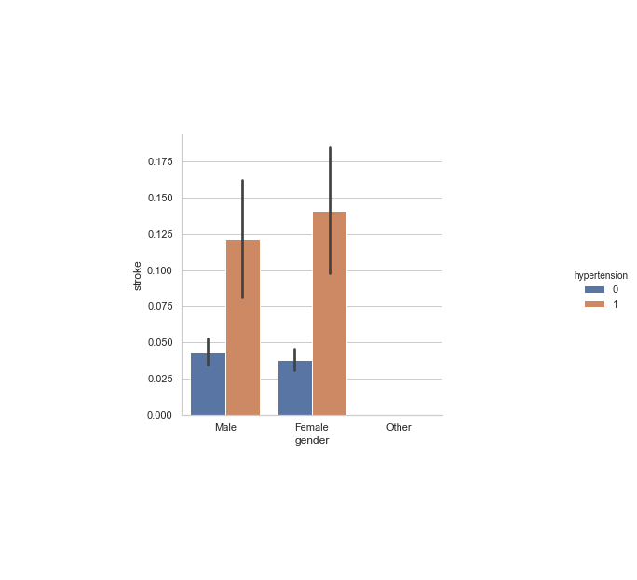
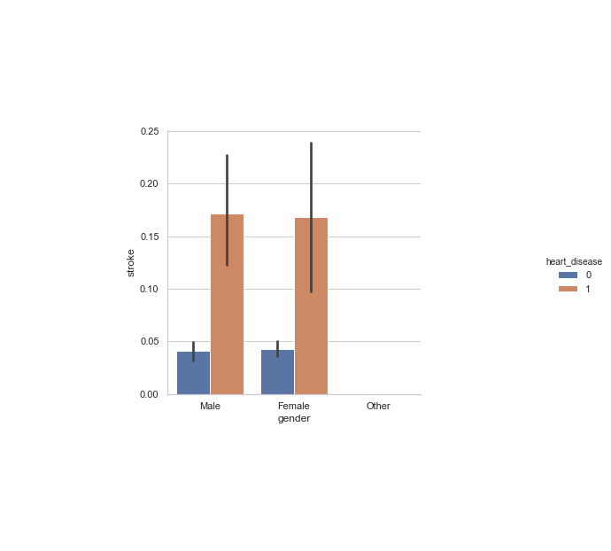
Data Exploration and Statistical Analysis

Slide 11
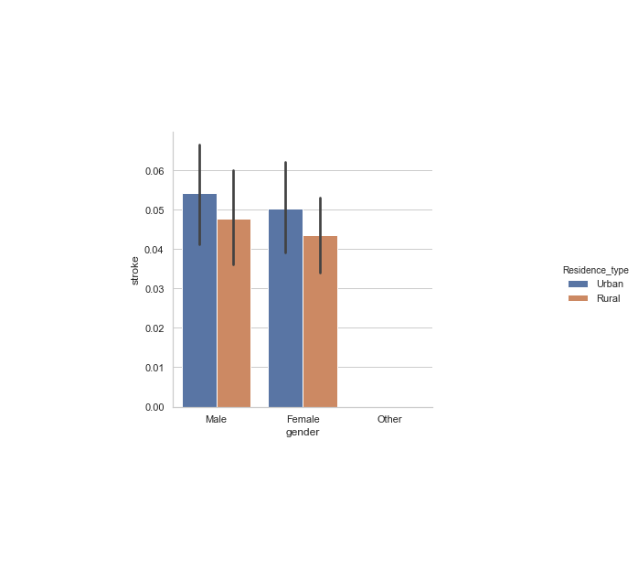
Data Exploration and Statistical Analysis
The insights we can get from the plots that gender doesn't show stroke having a greater impact We also observerd that their is a correlation between stroke and heart disease as well as hypertension Another observation is that we can see the difference between people in rural areas and urban areas. Urban get more stroke while rural people get stroke

Slide 12
Statistical Analysis
 | Age | Gender | Hypertension | Heartdisease | Ever_married | BMI | Avg_glucose_level | Smoking_status | Work_type
Stroke | 0.242 | 0.008 | 0.127 | 0.134 | 0.108 | 0.11 | 0.08 | 0.028 | -0.03

Slide 13
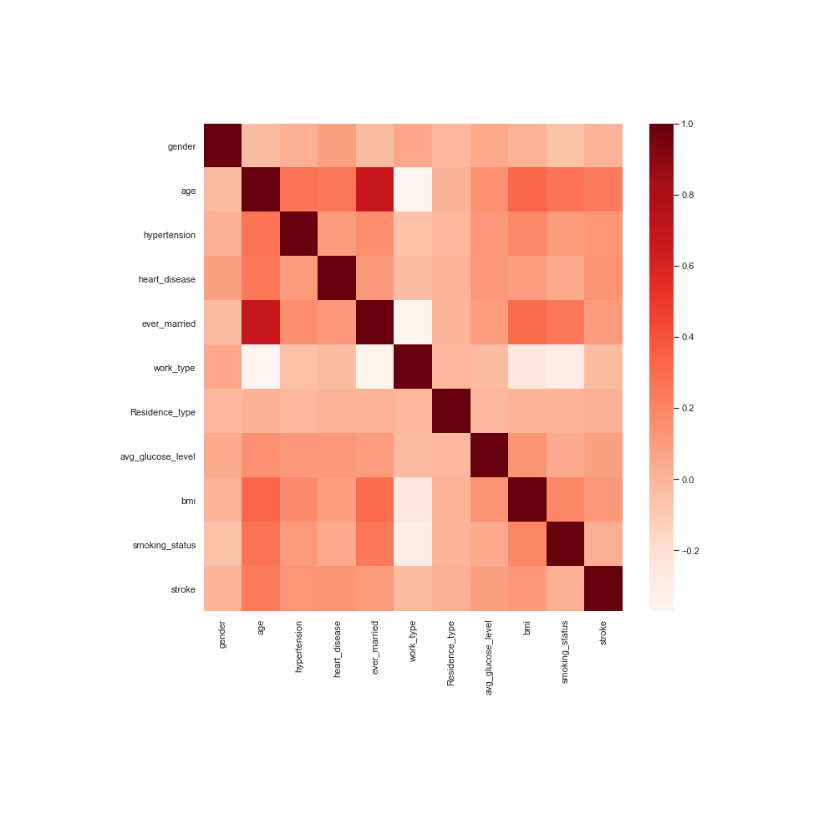
Preprocessing Missing Values

Slide 14
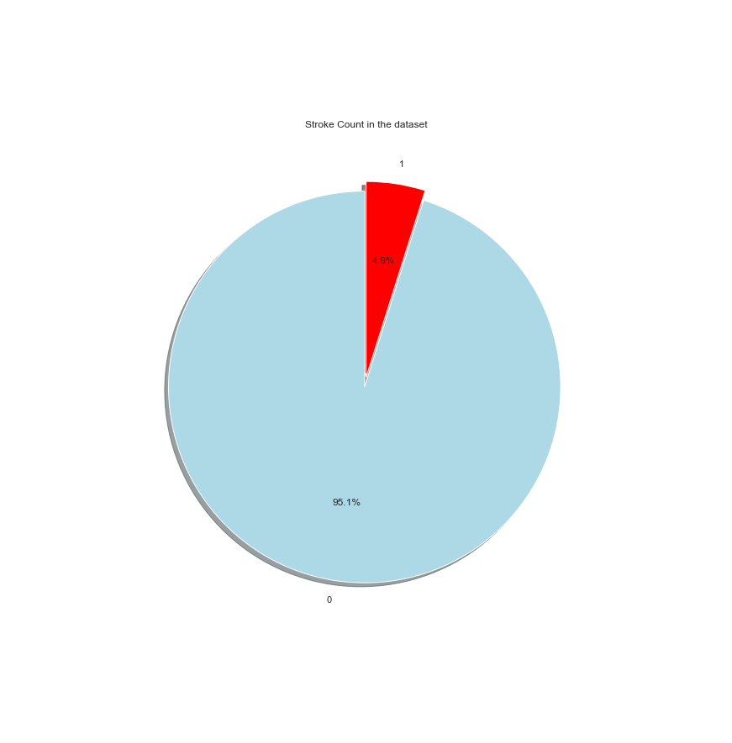
Imbalanced Target

Slide 15
Preprocessing Smoting Technique
 | Data
Before Smoting Stroke | 1=249 0=4861
After Smoting Stroke | 1=4861 0=4861
Shape of train data | X= (9722,10) Y=(9722)

Slide 16
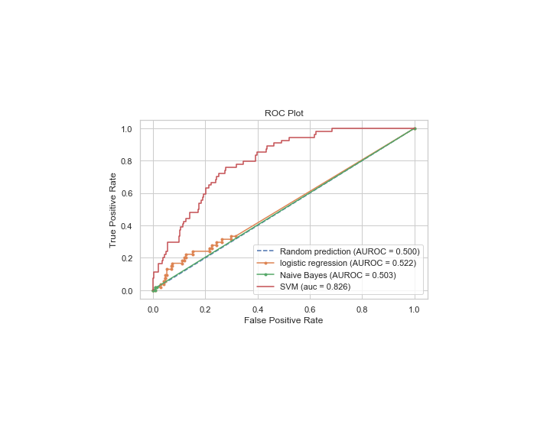
ROC curve
The three models that I have used for this project are
Logistic Regression
Naïve Bayes
SVM

Slide 17
Results
 | Precision | Recall | Accuracy | Fl score
Logistic Regression | 0=0.95 1=0.00 | 0= 1.00 1=0.00 | 94.618 | 0=0.97 1=0.00
Naïve Bayes | 0= 0.95 1=0.00 | 0=1.00 1=1.00 | 94.71 | 0=0.97 1=0.00
Support Vector Machines | 0=0.95 1=0.62 | 0=1.00 1=0.09 | 94.911 | 0=0.97 1=0.16

Slide 18
Selecting the Best Model
 | Best Score | Best Params
Logistic Regression | 0.94227164036346 | 'C': 5
Naïve Bayes | 0.8037447149139046 | 'var_smoothing': 2.848035868435799e-08
Support Vector Machines | 0.9471640363462459 | C': 1, 'kernel': 'rbf'

Slide 19

Summary
We can conclude from our analysis that the best factors that we need to consider in
determining stroke is age, heart disease, hypertension, BMI.
From our analysis we can conclude that the best model with the best parameters is the Support Vector Machine Model in determining stroke as it has 94 percent stroke. This can also be seen through grid search and cross validations performed. The parameters are C:1,’Kernel’rbf.
The limitations of the data set are that it contains only 11 features . They are important features, but with having another 10 to 20 features a process of elimination can be performed and the best features can be chosen.
The next steps that we can take with the data set is using neural networks, deep learning in order to detect stroke in a more profound way.
The future for detecting stroke and helping the community in treating this illness can be done by using images of strokes and then performing analysis on it using AI. So, stroke can be detected easily and treated.
Notes:
Photos by creativeart / Freepik

Slide 20

THANK YOU
Notes:
Photos by Freepik

